Slide 1
200 Years of Game DESIGN experience: A Study of the Champions and Items in League of Legends
by Tobi Adewoye

Slide 2
Overview
League of Legends (2009) is a Multiplayer Online Battle Arena game. It has over 160 different playable characters, which are also known as champions, and about a hundred items that players can buy in-game to increase their power levels.
As a result of the huge variance in games as a result of all the options, what is and isn't strong can be debatable.
To try and figure out by what metrics power can be measured in this game, I analyzed the League of Legends 2022 professional season and used the data to compare and contrast champions and items based on age, gold efficiency, win rates, and other metrics.

Slide 3

OVERVIEW

Slide 4
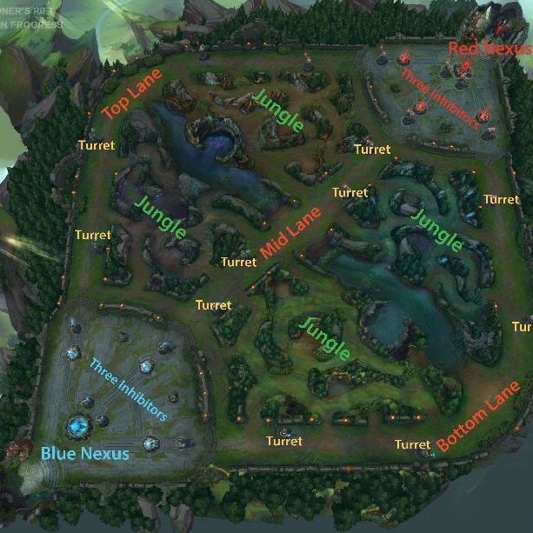
LANES

Slide 5
CLASSES
Assassin – Builds armor penetration and cooldown reduction items to assassinate weaker champions
Fighter – Builds health and attack damage to deal damage over time while sustaining themselves in fights
Mage – Builds ability power and cooldown reduction items to deal heavy damage
Marksman – Builds attack speed and critical strike modifiers to deal heavy damage over time
Support – Builds cooldown reduction to heal and shield allies
Tank – Builds health and resists to act as a shield for the rest of the team to hide behind

Slide 6
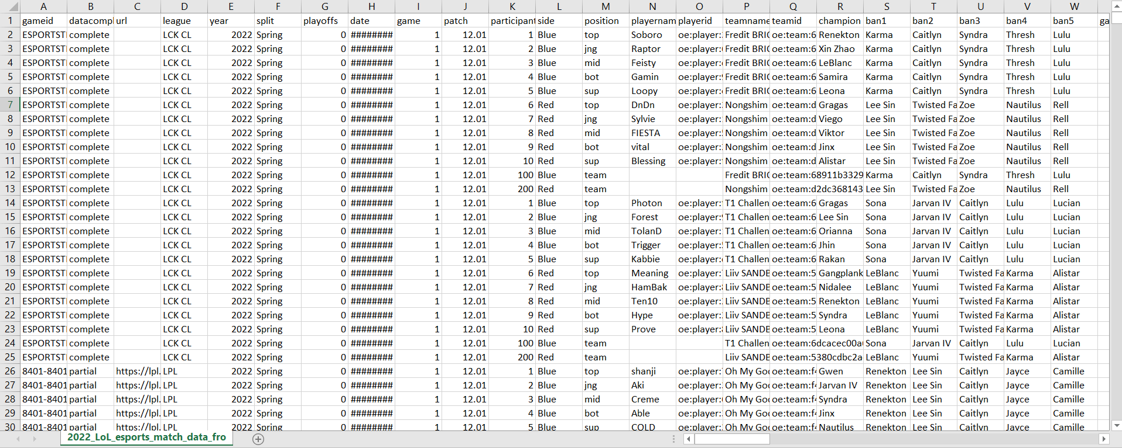
Dataset #1 – PROPLAY DATA
This dataset contains information on every proplay game played in 2022.
149,233 rows, 123 columns

Slide 7
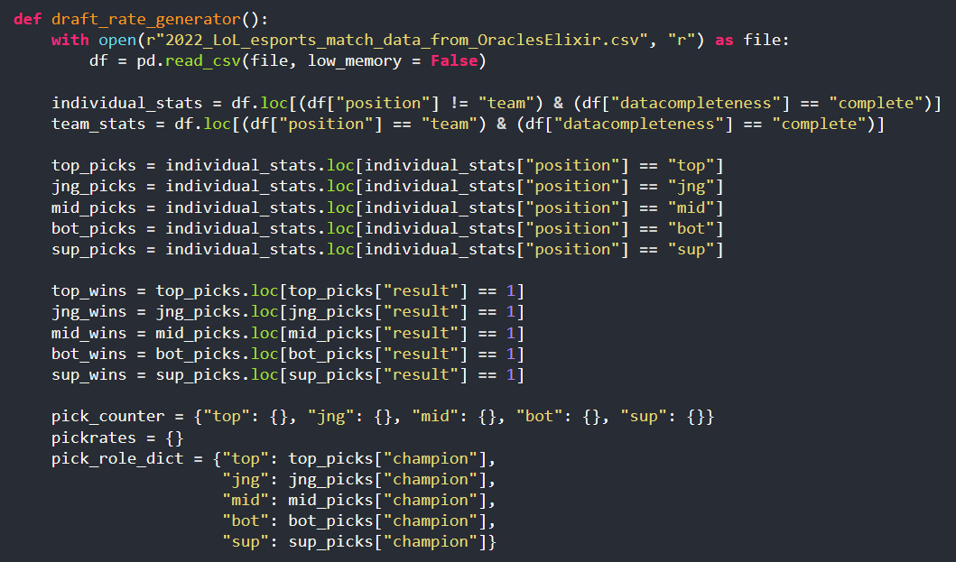
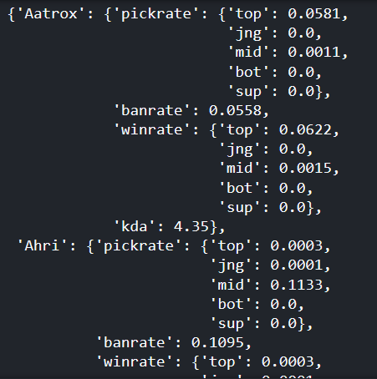
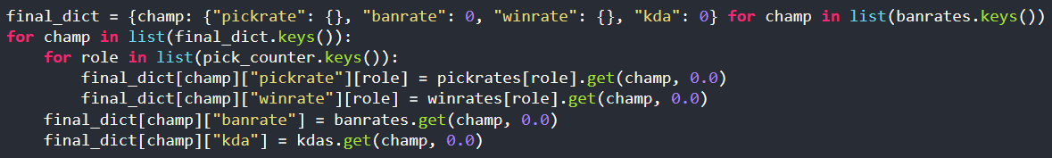
Dataset #1 – PROPLAY DATA
I cleaned the data with pandas.
The cleaned data contains information on each champion’s pick rate per role, ban rate, win rate per role, and Kill/Death/Assist ratio.

Slide 8
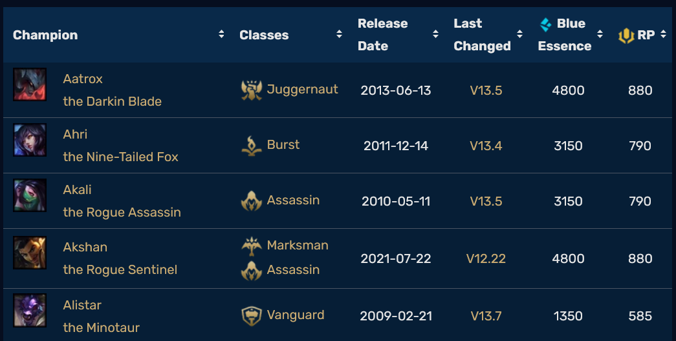
Dataset #2 – Champion information
This dataset contains information on all the champions in the game scraped from the League of Legends wiki using BeautifulSoup.
Because some champions have received major reworks since they released, I judged a champion’s age based on the date of their last major gameplay rework if they have one.

Slide 9
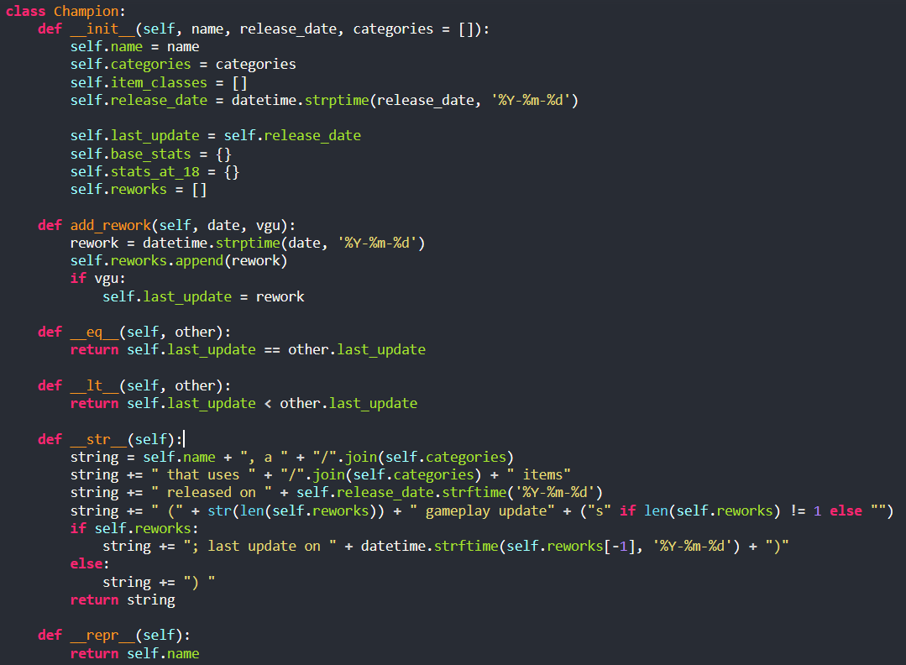
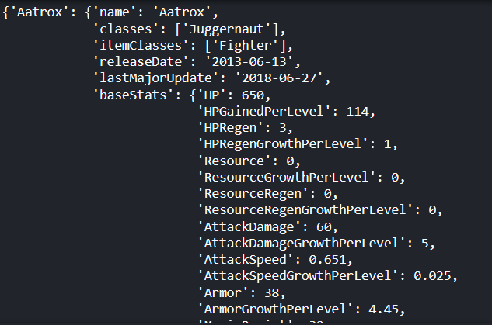
Dataset #2 – Champion information
The cleaned dataset was created using list and dictionary comprehensions, coupled with a custom class. The data was stored in a json file.

Slide 10
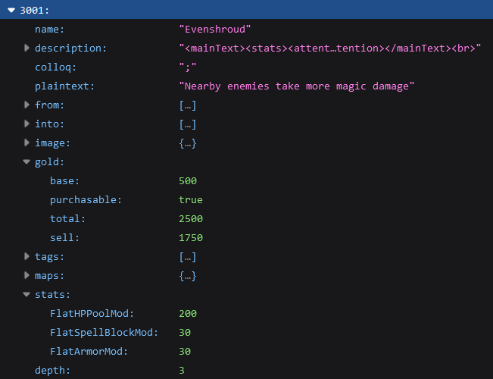
Dataset #3 – ITEM Information
The dataset contains item statistics, and was obtained using my API key for the League of Legends API with the requests module. I coupled this dataset with information on the gold efficiency of each item, which was scraped from the wiki.

Slide 11
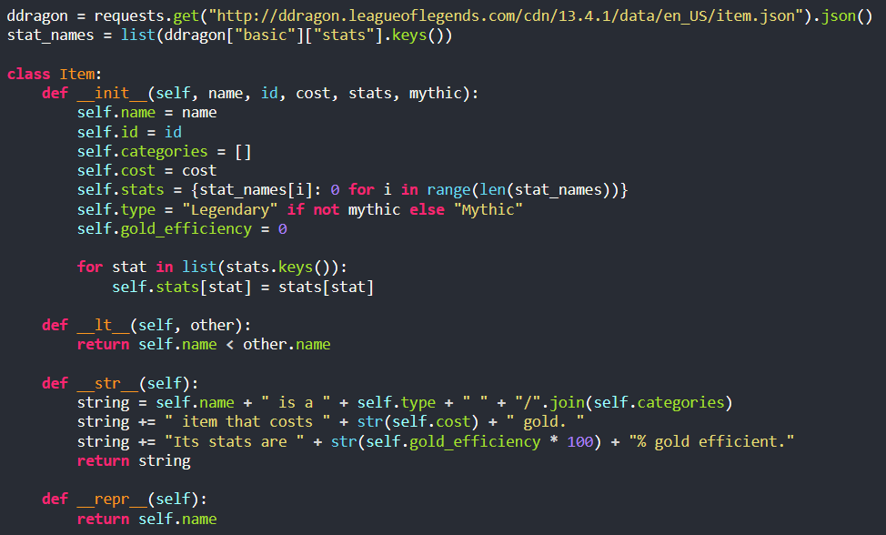
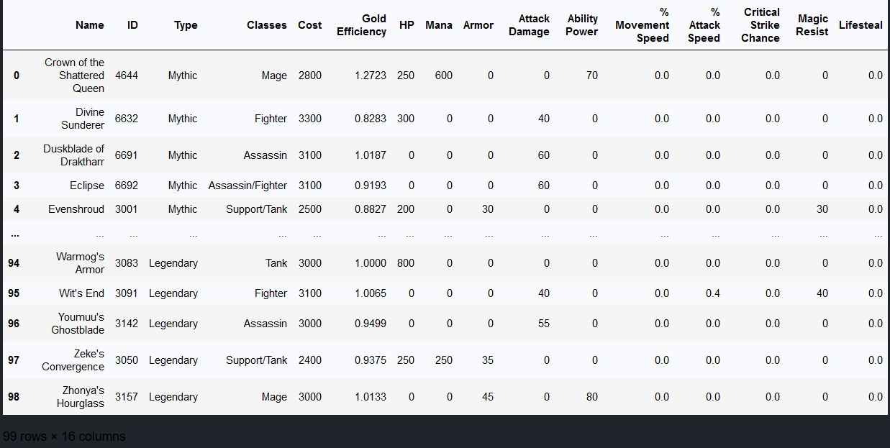
Dataset #3 – ITEM Information
The cleaned dataset was created using a custom class and list and dictionary comprehensions. I had to specially exclude items outside of the scope of the project, and get rid of irrelevant stats.

Slide 12
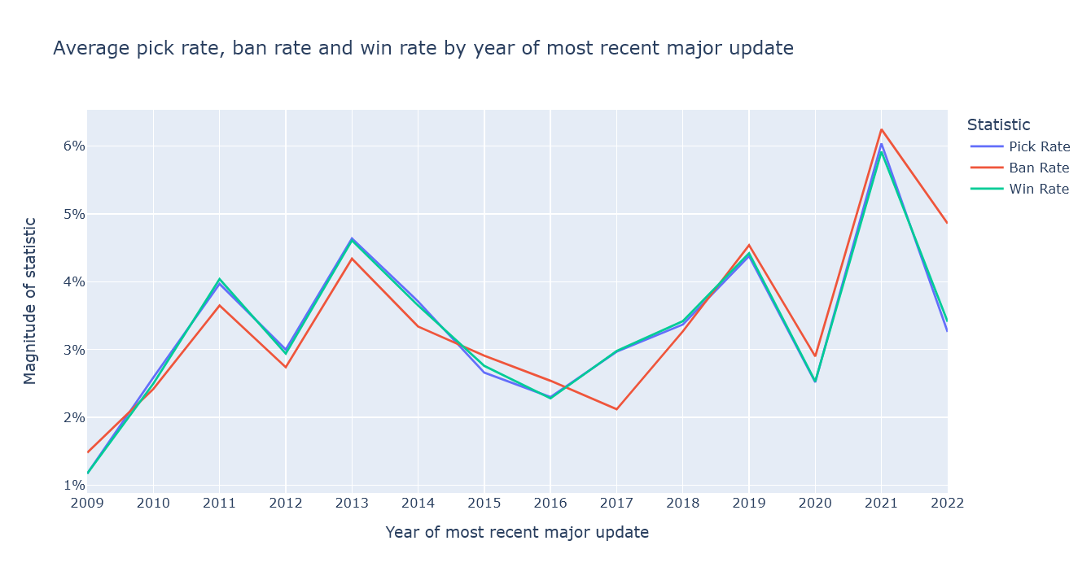
Insight #1 – AGE VS Pick/ban/win rates

Slide 13
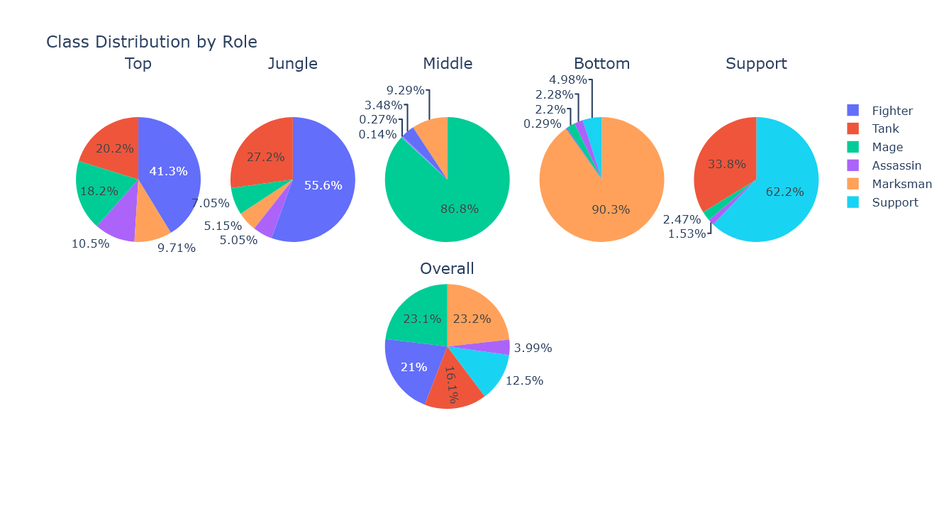
Insight #2 – Class distribution by role

Slide 14
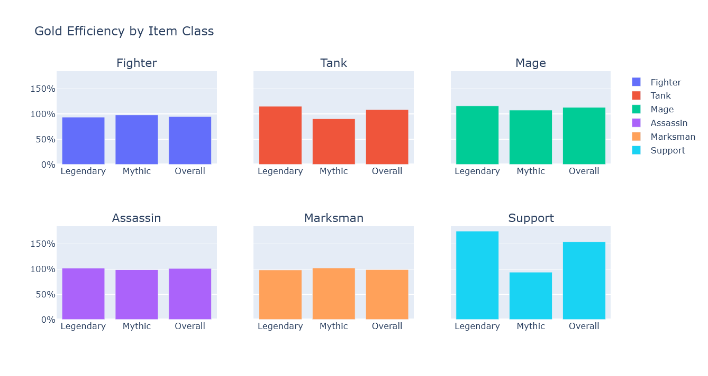
Insight #3 – GOLD EFFICIENCY BY ITEM CLASS

Slide 15
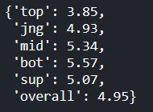
Insights #4 and #5 – roles and their average k/d/a and banrates

Slide 16
RESULTS AND CONCLUSION
Because of how multifaceted the game is, it is difficult to point to any single metric and say that it can serve as a way of measuring the balance of anything in the game.
However, there is a slight implication that newer champions are somewhat stronger than older ones.

Slide 17
CHALLENGES
I had a tough time using pandas and Python’s built-in OOP functionality, because I still don’t 100% understand how they work.
I think embarking on this project really helped me get a better understanding of data manipulation.

Slide 18
THANK YOU!

